Slide 1

Machine Learning-Based Dynamic Pricing Engine
An intelligent system that predicts optimal product prices using demand patterns, inventory levels, competitor data, and temporal behavior—powered by LightGBM and production-ready architecture.
Presented by: Jagathishwaran Parthiban
Domain: Data Science
Date: 10th January 2026

Slide 2


The Business Challenge
Static Pricing Falls Short
Traditional fixed pricing can't adapt to:
Real-time demand fluctuations
Inventory pressure dynamics
Competitive price movements
Seasonal and temporal patterns
Manual updates are too slow and resource-intensive for competitive markets with hundreds of products.
The Solution
ML-driven system that automatically predicts optimal prices across multiple products in real-time

Slide 3






End-to-End System Architecture
SQL Server Data Layer
Historical train and test datasets with product, pricing, and market data
Python Feature Engineering
Time-series transformations, lag features, business logic integration
LightGBM Pricing Model
Gradient boosting regressor optimized for non-linear pricing patterns
Future Price Predictions
Daily forecasts for each product with confidence intervals
Business Intelligence
Monthly aggregation and Tableau-ready visualization outputs
Production-grade pipeline designed for enterprise deployment—not a prototype

Slide 4

Data Foundation & Feature Engineering
Core Data Sources
Engineered Features
From SQL Server:
Temporal:
Product ID & Timestamp
Month, Day of Year, Weekend flags
Base Price History
Demand Index
Lag Features:
Inventory Levels
Price (1-day & 7-day lookback)
Competitor Pricing
Seasonal Indicators
Business Logic:
Price Gap (vs competitor)
Inventory Pressure (demand/inventory ratio)

Slide 5

Time-Series Rigor & Leakage Prevention
Temporal Ordering
1
All data sorted by product ID and timestamp—maintaining chronological integrity throughout the pipeline
Time-Based Split
2
80/20 train/test split based on time, not random sampling—ensures model sees only historical data
Lag Feature Strategy
3
Last 7 days of training data appended to test set—provides correct lookback values for future predictions
Industry best practice: No future data leakage. Every prediction uses only information that would be available at prediction time.

Slide 6

Model Selection Rationale
Why LightGBM?
Non-Linear Mastery
Captures complex pricing behaviors that linear models miss
Feature Synergy
Excels with mixed temporal and business features
Production Speed
Fast training and inference—scalable to thousands of products
Memory Efficient
Handles large datasets without infrastructure burden
Model Type
Target Variable
Prediction Horizon
LightGBM Regressor
Next-day product price
Daily forecasts

Slide 7



Model Performance Metrics
96%
3%
Accuracy Range
MAPE
R² Score indicating strong predictive power
Mean Absolute Percentage Error—business-friendly metric
Technical Metrics
What This Means
R² Score: 0.96–0.97
Strong generalization to unseen data. No signs of overfitting. Model performs consistently across all product categories.
MAE: Very low absolute error
RMSE: Minimal squared error
3% prediction error translates to highly reliable pricing decisions—acceptable for enterprise deployment

Slide 8
Future Price Forecasting Logic
01
02
03
Test Data Preparation
Lag Feature Generation
Business Rules Integration
Same feature engineering pipeline applied to future time periods
Historical prices used to create lookback features for forecasting
Competitive pressure and inventory-demand dynamics incorporated
04
05
Encoding Alignment
Prediction Generation
One-hot encoding matches training schema exactly
Daily predicted prices output for each product in portfolio

Slide 9
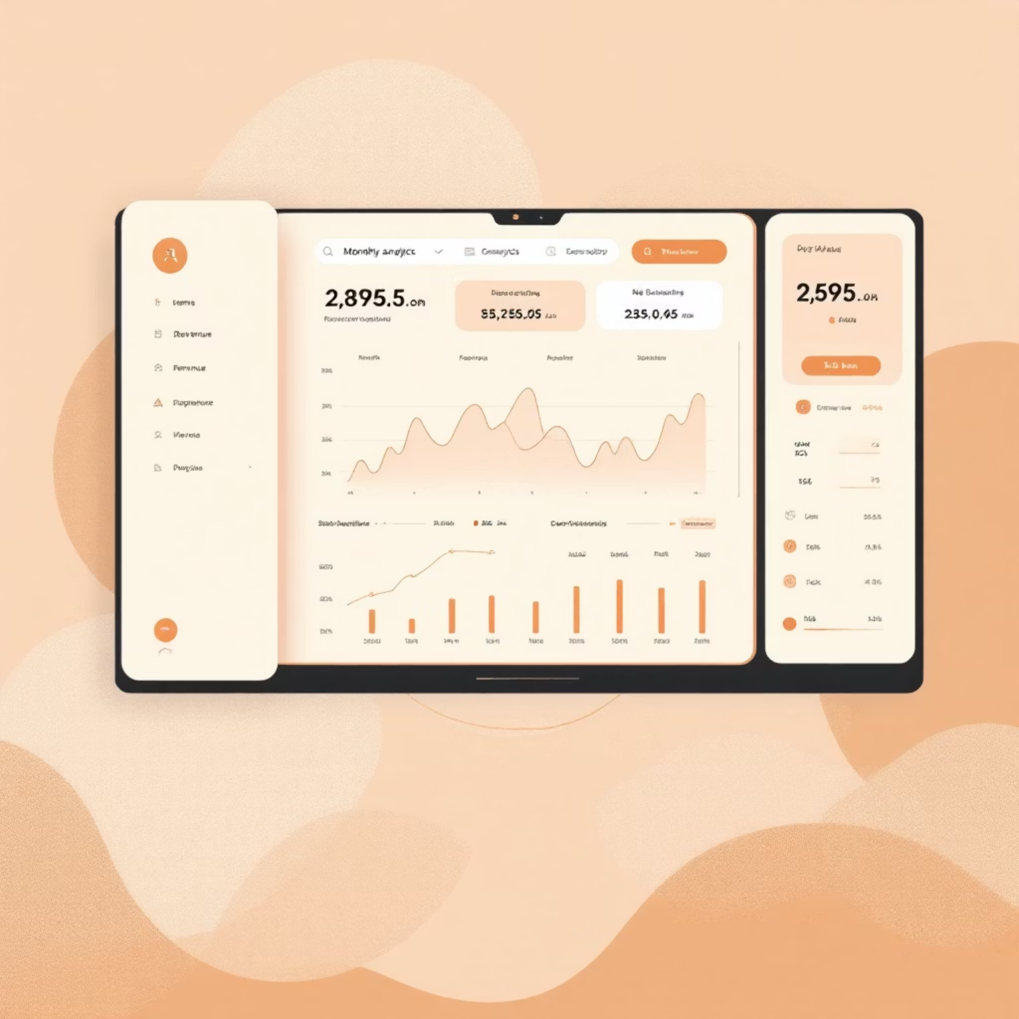



Monthly Business Intelligence
Aggregation Strategy
Daily predictions rolled up to monthly views for strategic decision-making
Comparative Analysis:
Actual (base) prices
ML-predicted prices
Price gap analysis
Coverage:
January, February, March forecasts
23 products analyzed
Tableau-ready format
Revenue Impact Analysis
Product-Level Strategy
Seasonal Planning
Quantify pricing strategy changes on topline revenue
Identify which products benefit most from dynamic pricing
Understand temporal patterns for future quarters

Slide 10
Enterprise-Level Pricing Intelligence
Technical Excellence
Business Applications
True dynamic pricing engine—not rule-based heuristics
E-Commerce
ML-driven with time-series integrity
Real-time pricing across thousands of SKUs
Leakage-free validation methodology
Retail Optimization
Supply chain and markdown strategy
Business-aware feature engineering
Revenue Forecasting
Production-ready architecture
Predictable topline planning
Competitive Strategy
Market-responsive positioning

Slide 11
Thank You

